Slide 1

By: Adnan Khan

Slide 2


CONCEPT AND DEMOGRAPHY
CAPITAL: Dhaka - largest city, political, financial and cultural center.
LOCATION: a country in South Asia
POPULATION: 168 Million
LANGUAGE: Bengali
GOVERN: Unitary parliamentary republic
CURRENCY: Taka
POPN. DENSITY: 1,070 / sq km
CDR = 5.35/1000
Under 5 MR = 38/1000 live births
TFR = 2.1
Life Expectancy at birth – 71 (m) and 73 (f)
Fully Immunized Children- 52 %
MMR = 176/1,00,000
IMR = 136/1000 live births

Slide 3
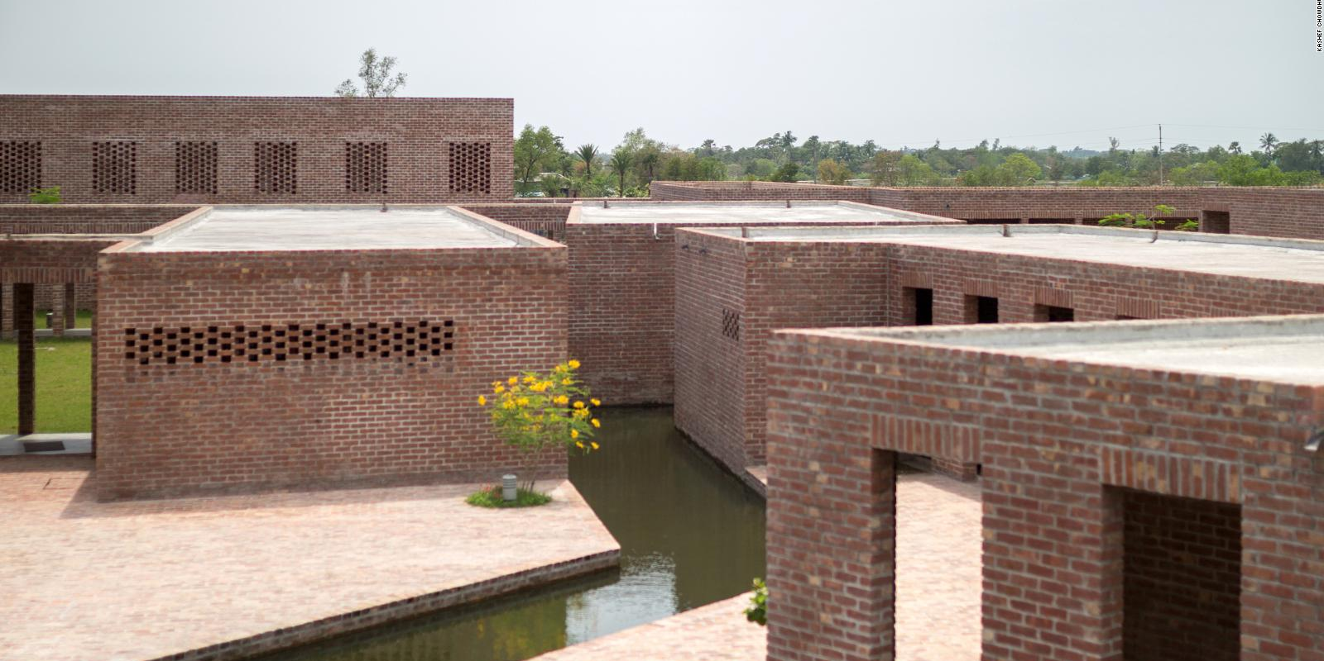

HISTORY ON HEALTH DEVELOPMENT

Slide 4
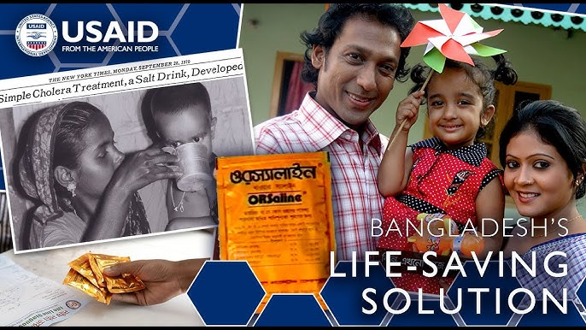
NGO partnerships (e.g., Bangladesh Rural Advancement Committee (BRAC) TB programs).
Post-Independence (1971): Inherited a fragmented system. Focused on rebuilding infrastructure with WHO/UNICEF support. Established the Essential Services Package (ESP) for primary care.
1980s: Oral Rehydration Solution (ORS), pioneered by ICDDRB, reduced diarrheal deaths by 50%.
2000s: - Launched the Health, Nutrition, and Population Sector Program (HNPSP).
- Expanded Community Clinics to provide maternal care, family planning, and basic treatment.
2020: National Health Policy emphasizing Universal Health Coverage (UHC) and non-communicable diseases (NCDs).

Slide 5
DEMOGRAPHIC PROGRESS: A JOURNEY FROM 1971 TO 2021
POST INDEPENDENCE
1971
LIFE EXPECTANCY : 50 YEARS (1971)
CHILD MORTALITY (UNDER 5): 251 DEATHS PER 1000 LIVE BIRTHS
2021
31 DEATHS PER 1000 LIVE BIRTHS
TOTAL FERTILITY 6.6 (1975) --> 2.0
72 YEARS (2021)
2021

Slide 6
The health system of Bangladesh is a mixed model governed by the Ministry of Health and Family Welfare (MOHFW). It operates on three tiers.
Union Level
4498 Union Health and Family Welfare Centers (UHFWC); provides Primary Healthcare; 30,000 population each.
Upazila Level
481 Upazila Health Complexes (UHC); provides both in-patient and out-patient care; 31-50 beds.
District Level
64 District Hospitals (DH); both primary and tertiary care; both in-patient and out-patient care.
Regional Level
14 Medical College Hospitals (MCH); provides tertiary care; 250-1400 beds.

Slide 7



Organizations
GoB has contracted some of its services to NGOs which include immunization, nutrition and TB control.
Preventive and basic care
NGO’s
Dominates urban areas, accounting for ~70% of outpatient care. Includes clinics, diagnostic centers, and hospitals.
Curative care
Private
Provides free or subsidized services, focusing on maternal health, immunization, and infectious diseases. Covers ~30% of healthcare demand.
Both curative and preventive
Public

Slide 8
Key Principles
Equity
Targeting underserved rural populations and urban slums.
Accessibility
Expanded via 18,000+ community clinics.
Affordability
Free maternal care, subsidized medicines for chronic diseases.
Digital Health
Initiatives like e-Mushak (digital drug tracking) and Telemedicine services in rural areas.

Slide 9
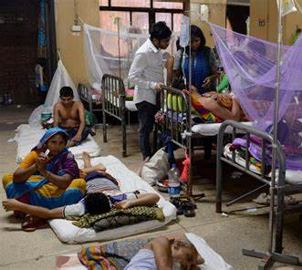
OUTBREAKS FROM DISEASES

Slide 10

DISEASE PATTERN: TOP 10 CAUSES OF DEATH
STROKE
COVID 19
CHRONIC OBSTRUCTIVE PULMONARY DISEASE
LOWER RESPIRATORY INFECTIONS
OESOPHAGUS CANCER
ISCHEMIC HEART DISEASE
ROAD INJURIES
TUBERCULOSIS
PRETERM BIRTH COMPLICATIONS
CIRRHOSIS OF THE LIVER

Slide 11
REACTION TO COVID-19 PANDEMIC
- First COVID-19 Case: March 8, 2020.
- Nationwide Lockdown: March 26, 2020.
Key Actions:
Suspension of public transport. - Closure of offices and educational institutions.
Vaccination & Public Awareness
- Vaccination Drive:
- Began in February 2021 (AstraZeneca, Sinopharm, Pfizer, Moderna).
- Mobile vaccination units for remote areas.
- Public Awareness:
- Campaigns to combat vaccine hesitancy.
- Use of media and community outreach
Economic & Social Support
Stimulus Package: $12 billion to support businesses and families.
Social Safety Nets:
Food aid and cash transfers for low-income citizens.
Education:
Shift to online learning for schools and universities

Slide 12
COMMUNICABLE DISEASES
Communicable Diseases | Causes | Preventive Measure
Dengue Fever | Dengue virus (mosquito) | Mosquito control, hygiene
Tuberculosis (TB) | Mycobacterium tuberculosis | Vaccination, early detection
Cholera | Contaminated water/food | Clean water, hygiene
Hepatitis B & C | Viral infection | Vaccination, safe needles
Typhoid Fever | Salmonella bacteria | Sanitation, hygiene
Pneumonia | Bacteria/Viruses | Vaccination, nutrition
COVID-19 | Coronavirus | Vaccination, masks

Slide 13
NON-COMMUNICABLE DISEASES
NON-COMMUNICABLE DISEASES | CAUSES | PREVENTIVE MEASURES
Heart Disease | Lifestyle, genetics | Healthy eating, exercise
Diabetes | Insulin resistance, diet | Low sugar diet, weight control
Hypertension | High salt, stress | Low salt diet, exercise
Stroke | High BP, smoking | Healthy diet, regular check-ups
Cancer | Genetics, smoking, chemicals | Screening, no smoking
Chronic Respiratory Disease | Pollution, smoking | Avoid smoking, clean air
Kidney Disease | Diabetes, high BP | Hydration, low salt diet

Slide 14
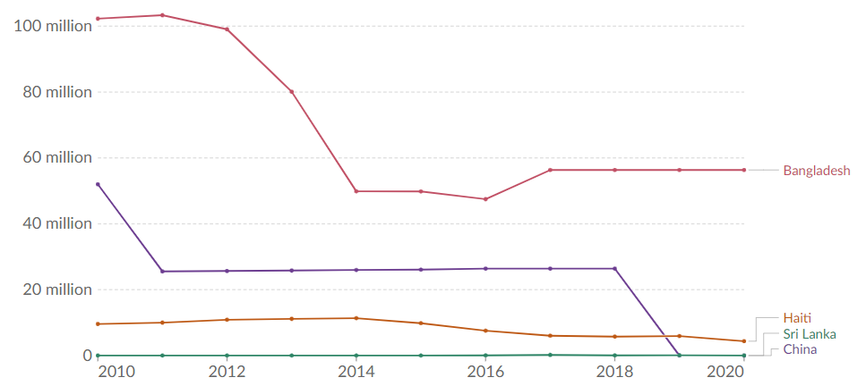
Neglected Tropical diseases
There is a huge burden of the Neglected Tropical Diseases (NTDs) in Bangladesh, particularly for Kala-azar; Lymphatic Filariasis, Dengue and Chikungunya.
On a global scale, Bangladesh has a higher overall prevalence of NTDs compared to other low-and-middle income countries like Sri Lanka, Haiti, China due to its larger population, tropical climate and socio-economic factors.

Slide 15

Nutritional Problems in the Country
2. Nutritional anemia: The most frequent cause is iron deficiency and less frequently folate and vitamin B12 deficiency.
1. Protein–energy malnutrition (PEM): The chief cause of it is insufficient food intake.
3. Iodine Deficiency Disorders: Goiter and other iodine deficiency disorders.
4. Xerophthalmia: The chief cause is nutritional deficiency of Vit-A.
5. Others: Lathyrism, endemic fluorosis etc.

Slide 16
1973-78: First Five-Year Plan
1976: The Population Policy
1980-85: Second Five-Year Plan
1985-90: Third Five-Year Plan
1990-95: Fourth Five-Year Plan
1997: The Health and Population Sector Strategy (HPSS)
1997-2002: Fifth Five-Year Plan
1998-2003: Health and Population Sector Programme (HPSP)
2000: Health Policy
2003-2010: Health Nutrition and Population sector Programme (HNPSP)
HEALTH POLICIES AND PROGRAMS
1973-78
1980-85
1985-90
1990-95
1997
1997-2002
1998-2003
2000
2003-10
1976

Slide 17
HEALTH INSURANCES AND STRATEGIES
Shasthyo Suroksha Karmasuchi (2016): Govn. Funded Health protection for people below BPL.
Health Insurance For Public Servants: Scheme for Govn. employees to enhance social protection
Community- Based Health Insurance (CBHI): Run by NGOs and microfinance institutions for underserved communities.
INNOVATION: Shift focus to Non- Communicable Diseases (NCD) and Robust Primary Health.
FUNDING: Increase Govt. Health Expenditure (Currently 0.7% Of GDP; Target 2-3%)
PRIMARY HEALTHCARE STRENGTHENING : Expand PHC Workforce, Equitable Resource Distribution
RESEARCH CULTURE: Leverage Institutions Like Matlab (ICDDRB’s rural real-world laboratory)

Slide 18
HEALTH POLICIES AND PROGRAMS
“low-hanging fruits”
Child Mortality
Fertility
“high-hanging fruits”
Effective PHC
Second-generation PHC
“Outside the Box” Innovations

Slide 19
KEY MILESTONES:
ORT REVOLUTION : BRAC'S ORAL REHYDRATION THERAPY PROGRAM (87% USAGE GLOBALLY).
IMMUNIZATION : COVERAGE EXPANDED FROM 2% (1978) TO 100% (2021); POLIO ERADICATED.
TB CONTROL : 70% CASE DETECTION; 90% TREATMENT SUCCESS.
SANITATION: OPEN DEFECATION REDUCED FROM 34% (2000) TO LESS THAN 1% (2015).
Dr. Dilip Mahalanabis invented the Oral Rehydration Solution (ORS) in 1971. ORS is a combination of water, glucose, and salts that treats dehydration and diarrhea.
During the 1971 Bangladesh Liberation war, ORS was a simple, cost-effective, and lifesaving treatment for diarrhea.

Slide 20
CHALLENGES IN HEALTH POLICY IMPLEMENTATION
FUNDING GAPS: High Out-Of-Pocket Spending (67% Of Health Costs)
INEQUITABLE ALLOCATION: Urban Bias, Underfunded Rural Areas
SYSTEM ISSUES
Low PHC Workforce Retention Due To Poor Salaries
RISING NCD BURDEN: 61% Of Total Disease Burden
ENVIRONMENT AND SOCIAL ISSUES
DENGUE/CHIKUNGUNYA OUTBREAKS LINKED TO URBANISATION.
MALNUTRITION PERSISTS: 1.85 Million With Diabetic Retinopathy

Slide 21
PROPOSED SOLUTIONS AND FUTURE DIRECTIONS
POLICY ACTIONS
Universal Health Coverage (UHS): Reduce Out Of Pocket Costs.
PHC EXPANSION:
Train And Retain Mid Level Health Workers.
NCD FOCUS
Integrate Screening Into PHC; Improve Diabetic Retinopathy Care.

Slide 22
DRIVERS OF SUCCESS
Women Empowerment, Microcredit Programs and Female Community Health Workers (CHWS)
Socioeconomic Progress : Educational Infrastructure, Poverty Alleviation.

Slide 23
Major programs
Expanded immunization: targets 9 diseases (TB, polio, measles, etc.).
Disaster Preparedness: cyclone shelters, early warning systems.
NCD management: national surveys to address diabetes hypertension and cancer.

Slide 24

INNOVATIONS
Dengue Vaccine: Clinical Trials Underway
Digital Health: Telemedicine For Rural Areas
Oral Cholera Vaccines (OCV) Were Prioritized, With Increased Production To Meet Demand.
Increase Govt. Commitment To Health Funding
Strengthen Partnerships (NGOs, International Bodies)
Strengthened surveillance systems to monitor HMPV (Human Metapneumovirus) cases and genetic variations.

Slide 25

CHALLENGES
Poor access to services, both primary and tertiary care.
Low quality services.
Child malnutrition and maternal mortality rate still remain among the highest in the world.
About 15,000 mothers die annually at the time of delivery, with 3 maternal mortality per 1,000 live births, and 7,000 infants die everyday.
70 per cent of pregnant mothers suffer from anemia, 86 per cent of deliveries take place at home, 36 per cent of children are stunted and 46 per cent of babies are born with low weight.
Four probable causes of poor access: (i) inefficient management of existing facilities, (ii) underutilization of available facilities, (iii) inadequate facilities, and (iv) urban biased health expenditure.
ISSUES | URBAN | RURAL | NATIONAL
Life Expectancy (in yrs) | 68 | 64.6 | 65.4
Under-5 Child Mortality (per 1000 live births) | 2.8 | 3.9 | 3.7
Infant Mortality Rate (per 1000 live births) | 35 | 46 | 44
Crude Birth Rate (per 1000 live births) | 17.7 | 21.4 | 20.6

Slide 26

SOLUTIONS
To address managerial problems, issues of maldistribution of human resources should be given serious attention.
To prevent absenteeism, a mechanism should be established to monitor and evaluate the performance of doctors and health workers.
To address the cost barrier leading to a lack of demand for service, a ‘voucher scheme’ for maternal health services under the demand-side-financing mechanism of HNPSP is underway.
To remove physical inaccessibility, as per policy commitments, although the government is supposed to establish one UHC in each upazila and one Health Centre in each union, till today 64 upazilas and 98 unions do not have any health facilities.
There is no magic bullet to improve the quality of health services but there is no denying the fact that efficient management of the vast workforce would lead to much more improved health services.
High maternal mortality rates are underpinned by the fact that about 85 per cent deliveries take place at home and most of which are attended to by untrained providers. Although the government has established physical facilities at upazila and lower levels and arranged BCC and training of doctors, nurses and field staff to provide emergency obstetric care (EMOC) at these facilities, the utilization of these services is still quite low.
Lack of awareness among the rural poor is one of the reasons for poor child health. To meet this challenge, health education and behavior change communication should be intensified particularly in low performing and hard to reach areas.

Slide 27

CONCLUSION
ACHIEVEMENTS: Dramatic improvements in life expectancy, child survival, and sanitation.
WAY FORWARD: Address, funding NCDS gaps and health inequities.
BANGLADESH'S LEGACY: A model for community-driven health innovation.

Slide 28
CONCLUSION (CONTINUED)
Due to the expansionary nature of its health policy, plans and programs, the health sector in Bangladesh has achieved remarkable successes in terms of quantitative indicators. However, the qualitative improvement is negligible. Managerial and governance weaknesses are the main causes of this deficiency.
Before the 1990s, managerial issues were emphasized less in policy documents. However, since the late 1990s issues like managerial efficiency and cost effectiveness have come to the forefront of Bangladesh’s health policy discourse, but with limited impact on the system so far. Without an improvement in governance and efficient management, the problems facing Bangladesh’s health sector are unlikely to be addressed.

Slide 29
REFERENCES
Health Policy, Programmes and System in Bangladesh, article by Ferdous Arfina Osman, University of Dhaka, Department of Public Administration.
Akter, Taslima and Shahidul Islam. 2006. Dhaka Medical College Hospital: A Diagnostic Study. Dhaka: Transparency International-Bangladesh.
Bangladesh Health Watch. 2006. The State of Health in Bangladesh 2006: Challenges of Achieving Equity in Health. Dhaka: BRAC University, accessed from http://sph.bracu.ac.bd/bhw/2006/Full_Report_2006. pdf (on 4 March 2008).
Bangladesh Bureau of Statistics (BBS). 2006. Statistical Yearbook of Bangladesh 2006. [26th edition] Dhaka: Bangladesh Bureau of Statistics.
Health policy in Bangladesh – Wikipedia

